Slide 1
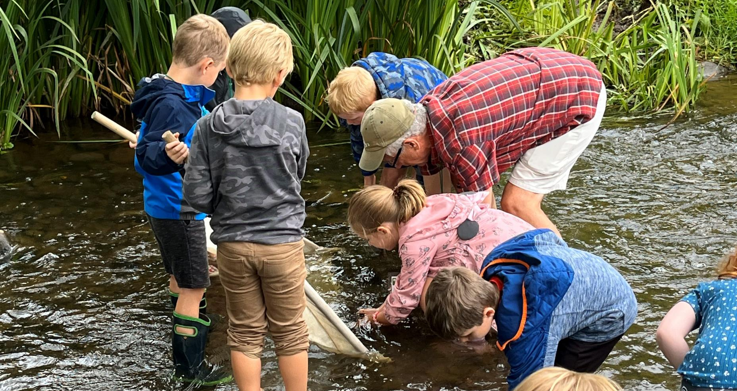

Town Board Presentation
Eaton - 2025

Slide 2
Serving Eaton
Ag In the Classroom @ Morrisville-Eaton
4-H Explorers’ Club
Open Farm Day – 2-3 Farms
Teaching Garden & Seed to Supper
Tax Counseling for the Elderly
SNAP-Ed @ Morrisville-Eaton
October 2024 – February 2025
  22 Workshops
  5 Calls & Inquiries

Slide 3
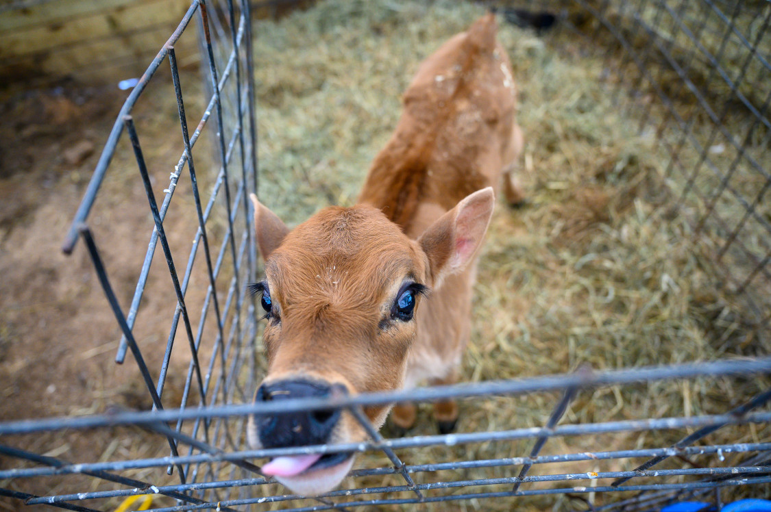
Cornell Cooperative Extension Madison County puts knowledge to work in pursuit of economic vitality, ecological sustainability, and social well-being. We bring local experience and research-based solutions together, helping Madison County families and communities thrive in our rapidly changing world.

Slide 4
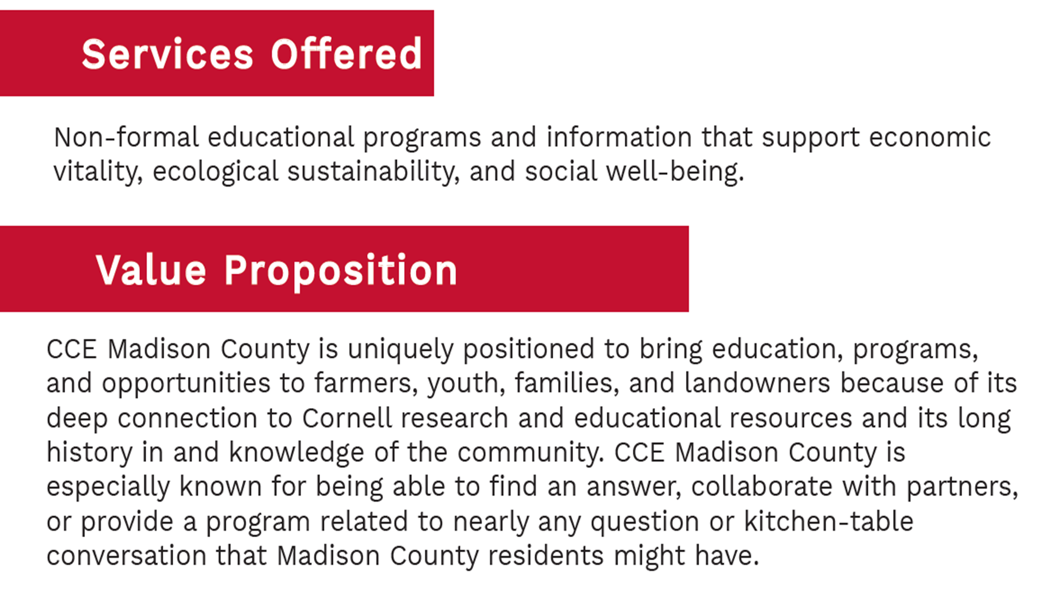

Slide 5
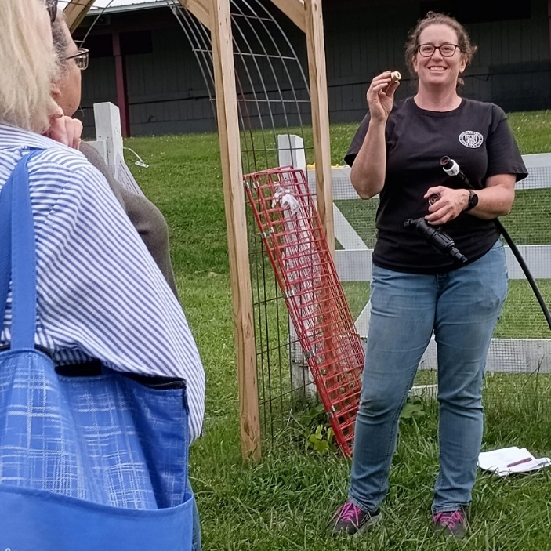
What is CCE?
True partnership between federal, state, and county government
County Law 224 statutorily authorizes establishment of CCE as:
  Subordinate governmental agency
  Local unincorporated organization of citizens of the county
  Operates under administration approved by Cornell
Subordinate governmental agency
Tax exempt under 501c3
Public Body
Irrigation Workshop

Slide 6
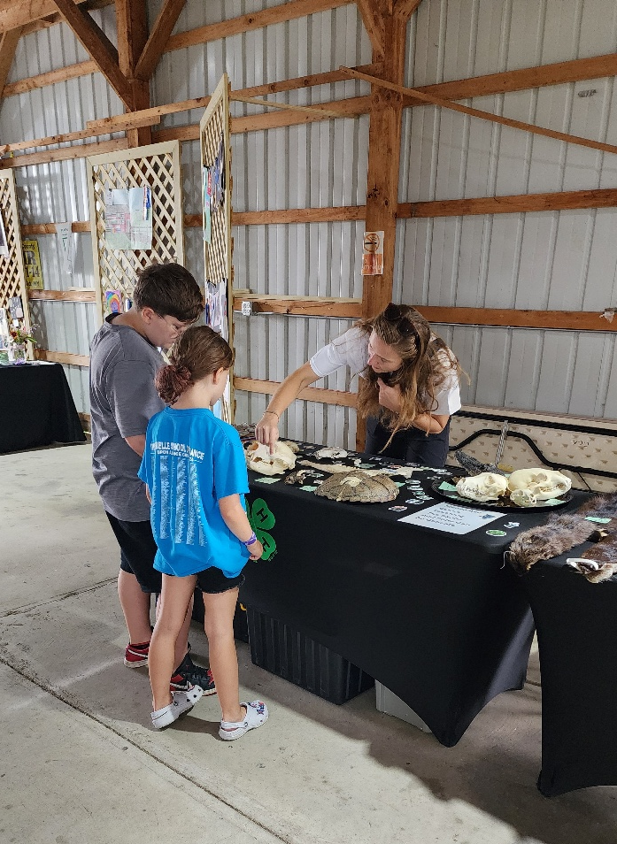
History & Foundations
1862 Morrill Act formed the Land Grant University System
1865 Cornell University incorporates
1887 Hatch Act created the ag experiment stations
1890 Morrill Act was genesis for HBCUs
1914 Smith-Lever Act formed Extension
1917 CCE Madison formed
2024 County Fair – Wildlife Exhibit

Slide 7
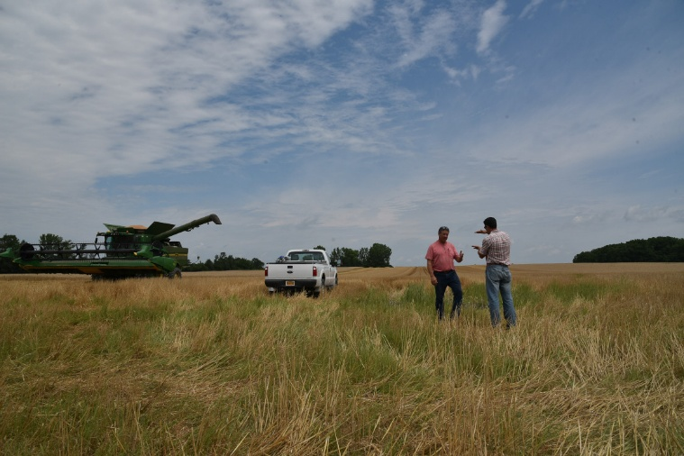
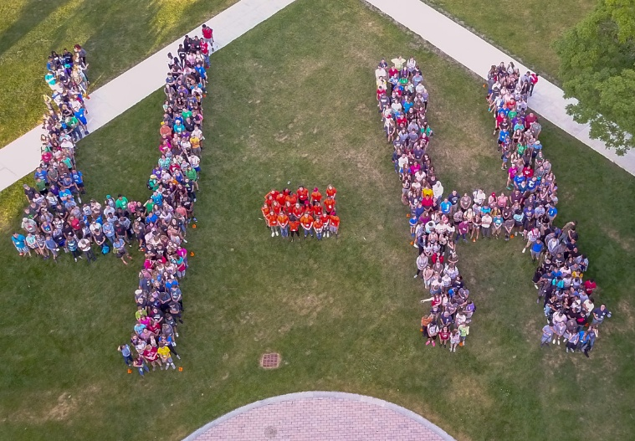
Statewide Mission Areas
Environment and Natural Resources, Sustainable Energy and Climate Change
4-H Youth Development/Children, Youth, Family
Nutrition, Food Safety and Security, and Obesity Prevention
Community and Economic Vitality
Agriculture and Food Systems

Slide 8
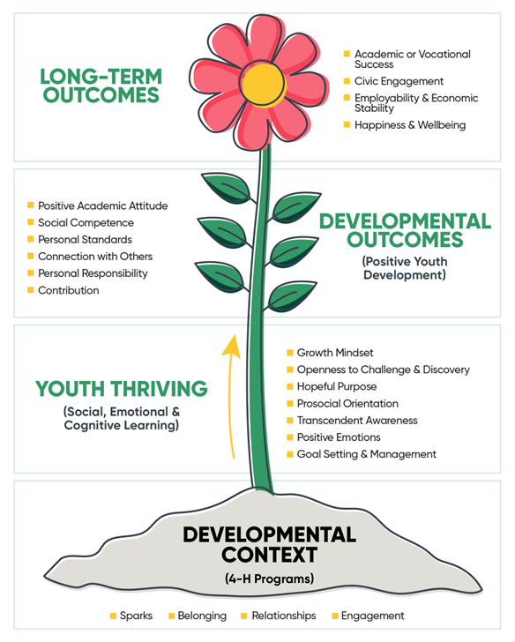
4-H Youth Development
Goal: to empower youth with the skills to lead for a lifetime through high-quality programs that promote youth thriving.
Flagship programs: Explorers’ Club, Ag In the Classroom, Public Presentations, Dairy Bowl, Fair, Camp, Statewide Experiences, and local Clubs

Slide 9
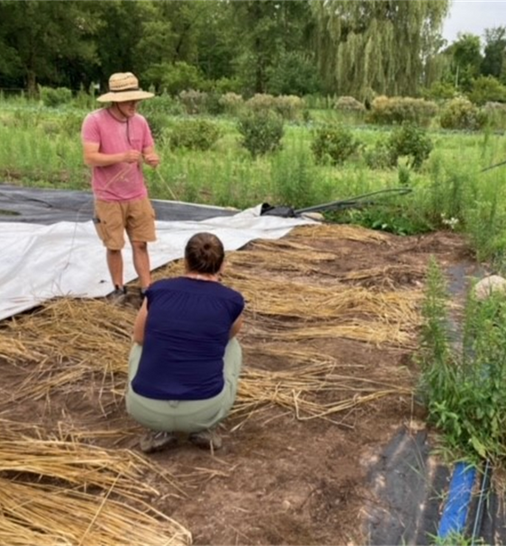
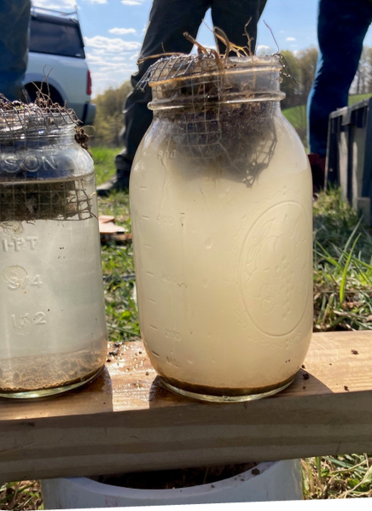
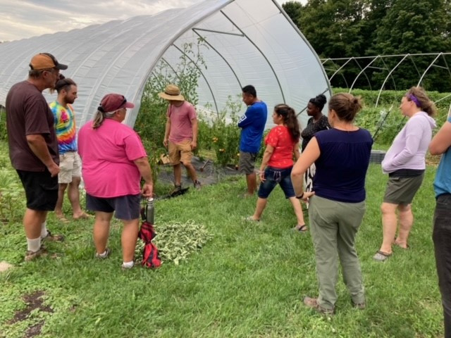
Agriculture & Horticulture (Commercial)
Goal: to promote and support increased agricultural output, use of best management practices through producer education, technical assistance, community building.
Flagship programs: soil testing, 1:1 farm consultations, and workshops on production topics

Slide 10
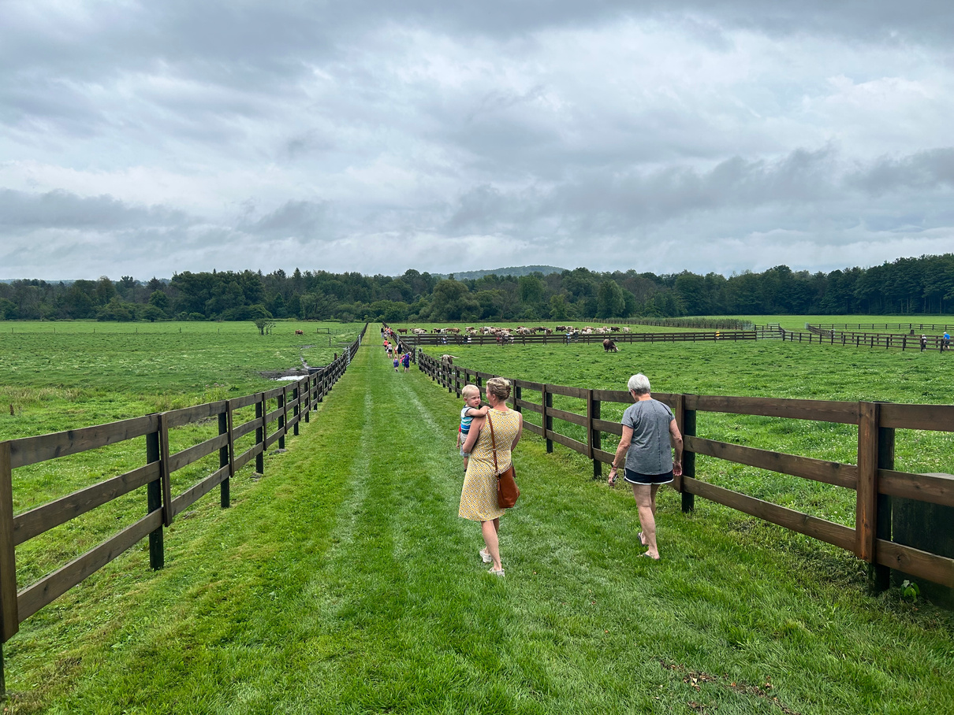
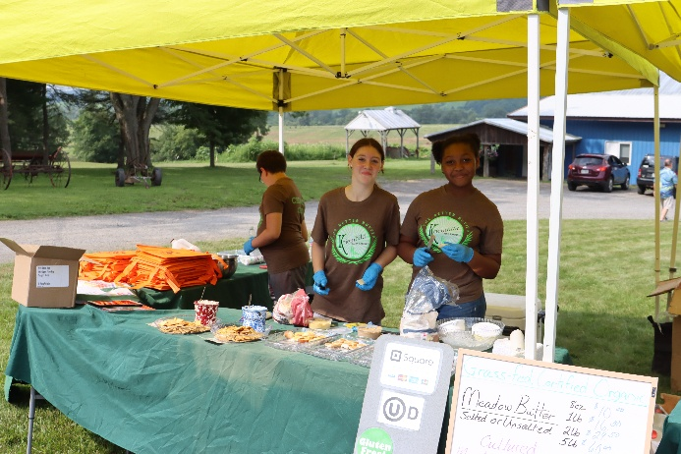
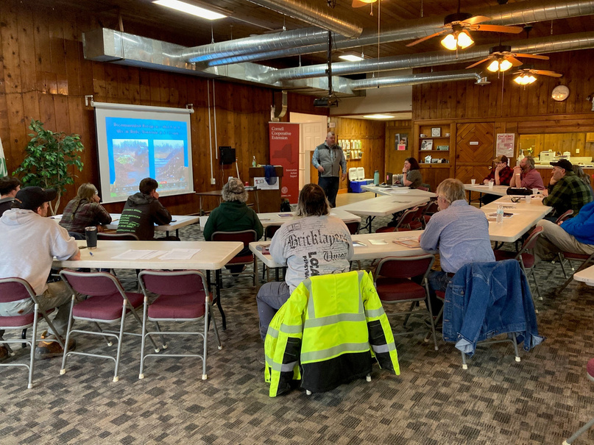
Agriculture Economic Development
Goal: to maintain, develop, and promote a viable agricultural economy that benefits Madison County
Flagship Programs: Open Farm Day, Celebrate Madison, Agritourism, Workshops & 1:1 Consultations on marketing, reaching new markets, etc.

Slide 11
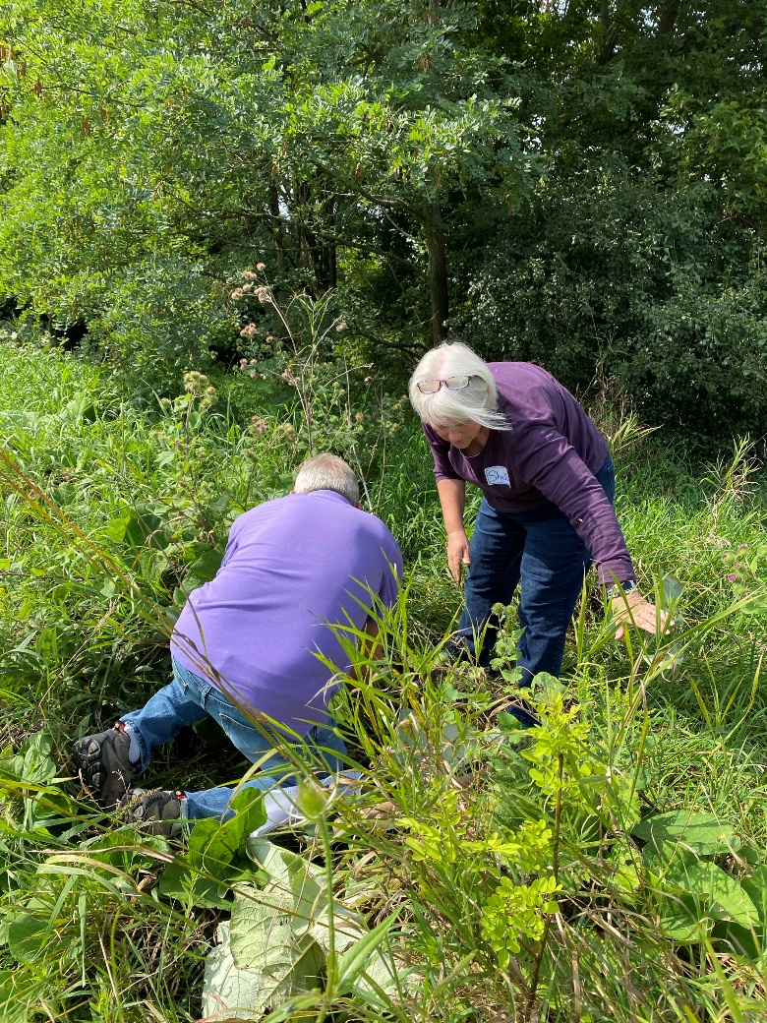
Environment
Goal: to support landowners to understand and manage their land to encourage healthy forests and waters, and to help youth and adults connect to the natural world.
Flagship Programs: Environment Day Camp, Master Forest Owners, Climate Steward Volunteers, Environmental Education Workshops

Slide 12
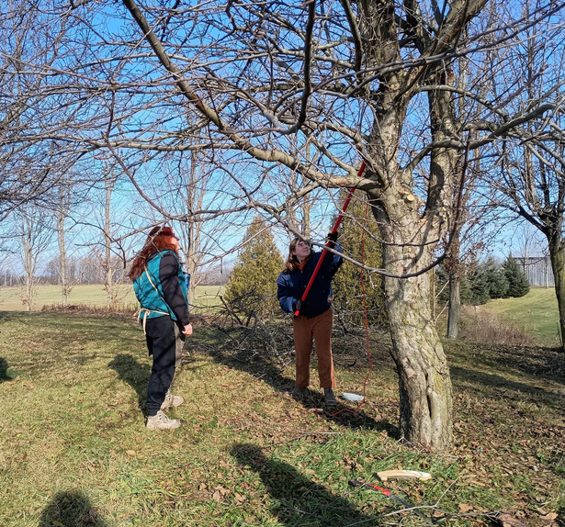
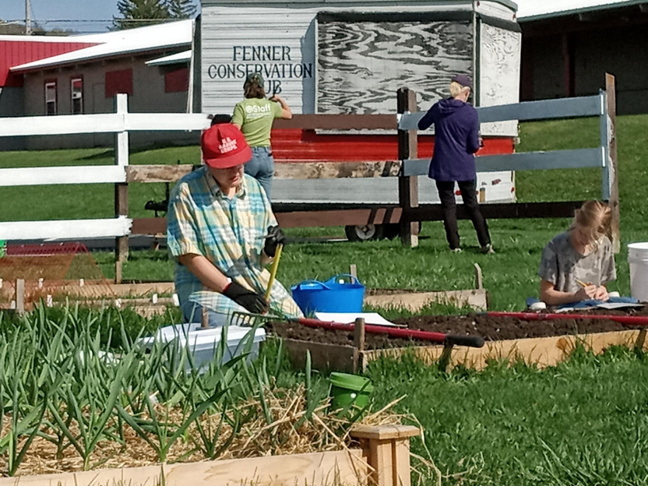
Community Horticulture
Goal: to extend research-based information on a variety of home and community-gardening topics to Madison County residents
Flagship programs: Master Gardener Volunteers, Seed to Supper, Food Preservation, Teaching Garden, Foraging

Slide 13
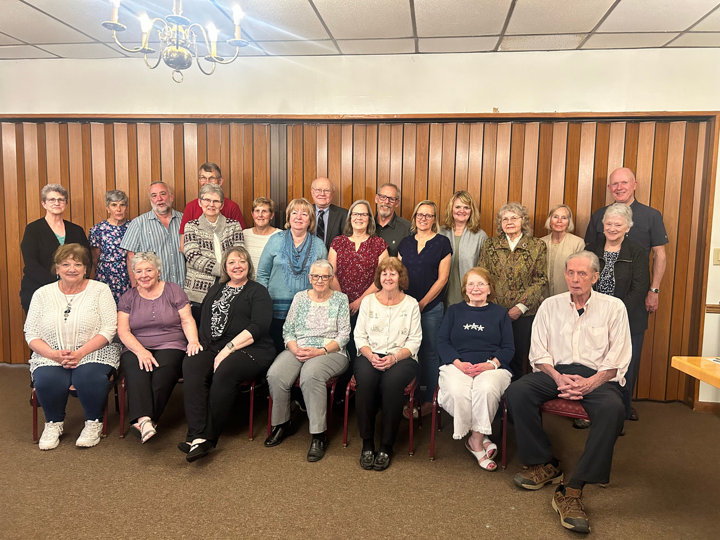
Tax Counseling for the Elderly
Goal: to train volunteers to help seniors & people with disabilities establish or improve economic security by maximizing their tax refund to increase savings and reduce debts.

Slide 14
Regional Programs
CNY Dairy, Livestock & Field Crops Team
SNAP-Ed Nutrition Education
Harvest NY
Shared Business Network
  $42,000 investment
  4 regional specialists
  Serve 8 counties
  Commercial agriculture
  $0 cost
  3 regional educators
  Serve 3 counties
  Low-Income Nutrition Education
  $0 cost
  Statewide team
  Ag Specialists
  Regional Farm to School Coordinator
  $13,000 investment
  Shared Finance, HR, and IT staff
  7 counties share expenses

Slide 15
Member | Town | Sector
Erick Haas | Sullivan | Ag Business
Jenn Murphy | Georgetown | Ag Business
Roger Saltman | Cazenovia | Veterinary
Lori Shephard | Cazenovia | Education (Secondary)
Sara Dougherty | Lenox | Agriculture & Education (Higher)
Paul Curtin | Cazenovia | Legal
Catherine Cardelus | Hamilton | Environment, Education (Higher)
Evan Sweeney | Cazenovia | Government
Asher Burkhardt-Spiegel | Madison | Production Agriculture
Shari Dann | Cazenovia | Environment, Education (Higher)
Dave Rogers | Nelson | Education (Higher)
Patrick Allen | Cazenovia | Production Agriculture

Slide 16
Let’s Connect!
Resources for Towns
  EDEN, Local Roads
Town-Level Clubs
  Location & Volunteers
Host or suggest workshops
Board & Committee Members
What are the needs?

Slide 17
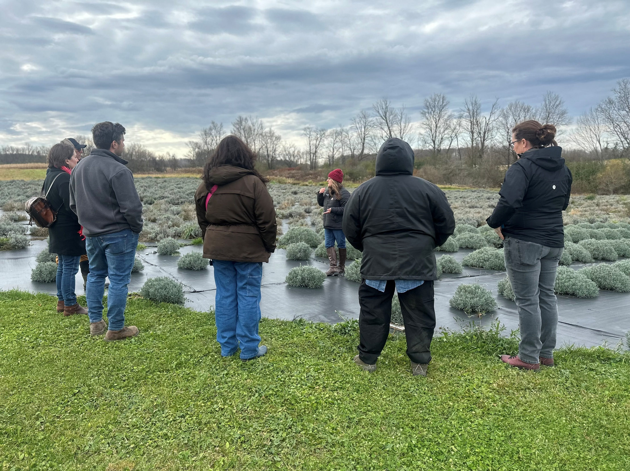
CCE is the go-to place for Madison County residents to access research-based information and programs that improve social well-being, ecological sustainability, economic and community vitality.

Slide 18
Contact Us!
Larkin Podsiedlik
llp36@cornell.edu
315-885-3886
www.ccemadison.org | Madison@cornell.edu

